Slide 1
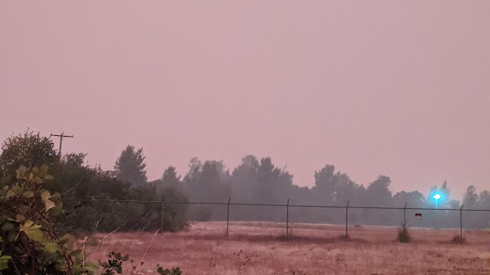

Slide 2
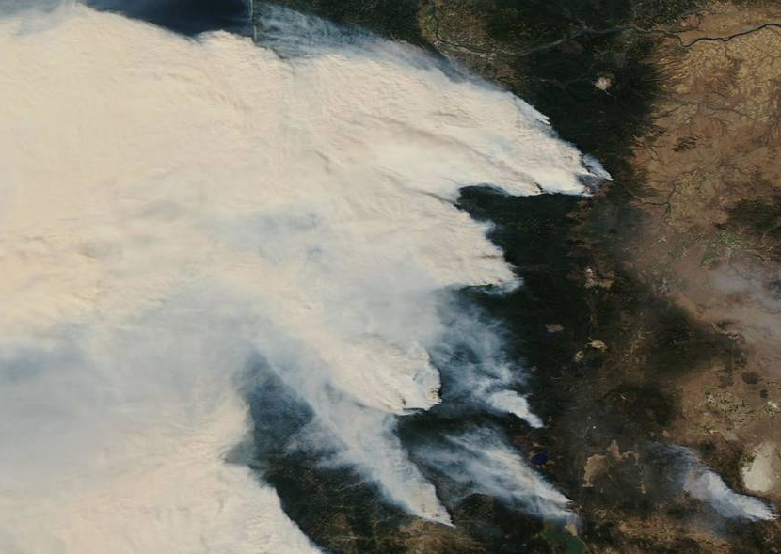

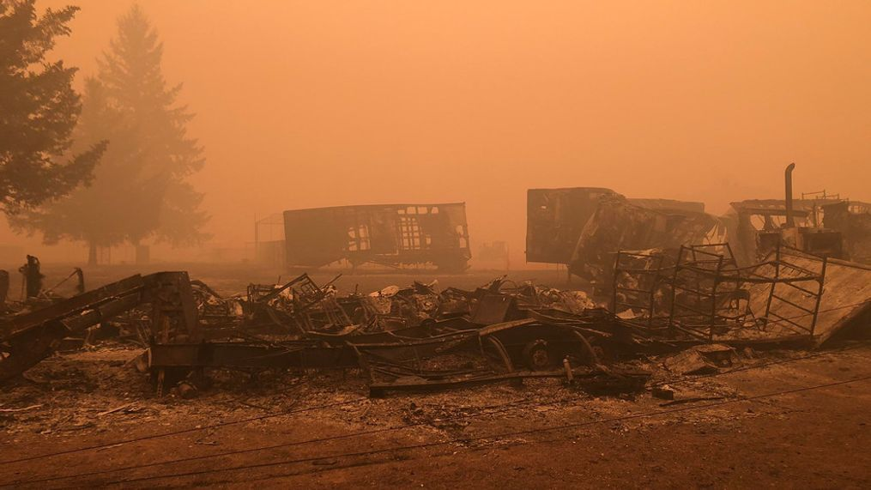
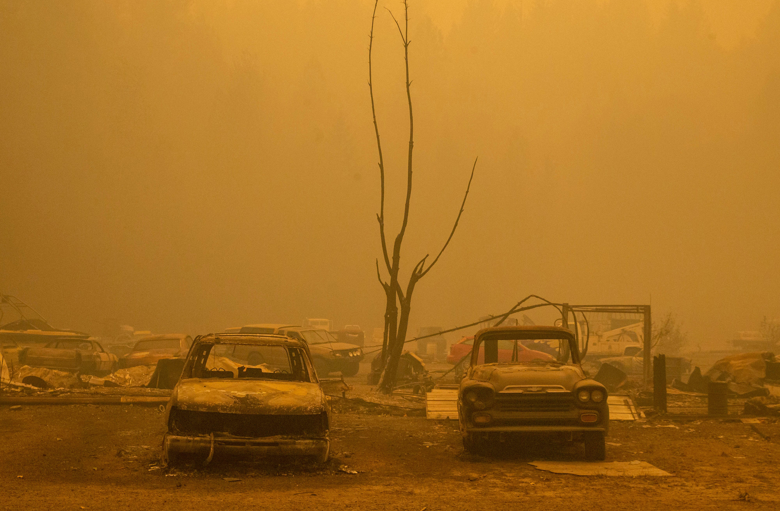
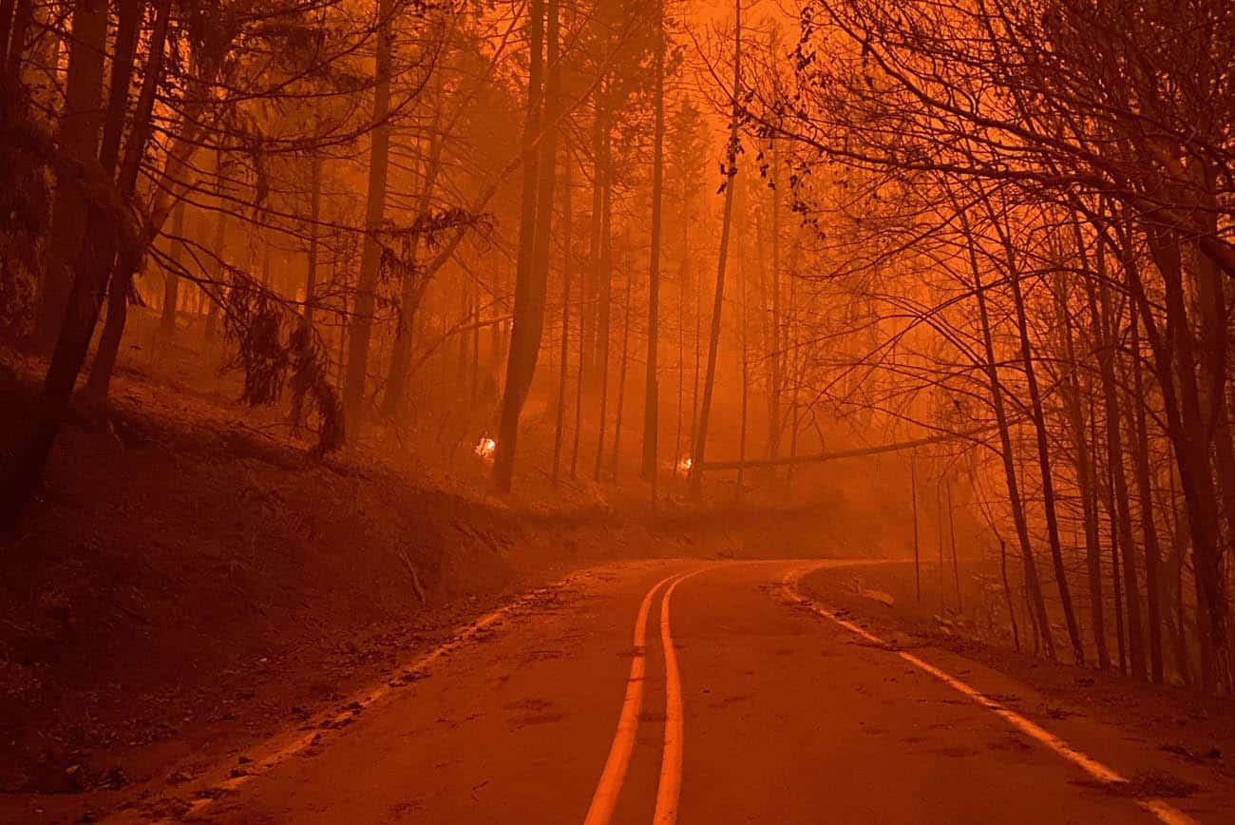
Portland
Riverside
Salem
Newport
Beachy-Creek & Lionshead
Beachy Creek & Lionshead
Corvallis
Bend
Eugene
Holiday Farm
Holiday Farm
Archie Creek
Archie Creek

Slide 3
“The 2020 Labor Day fires were a wake-up call to many scientists, forest managers, policymakers, and the public….”
– Reilly et al., 2022

Slide 4
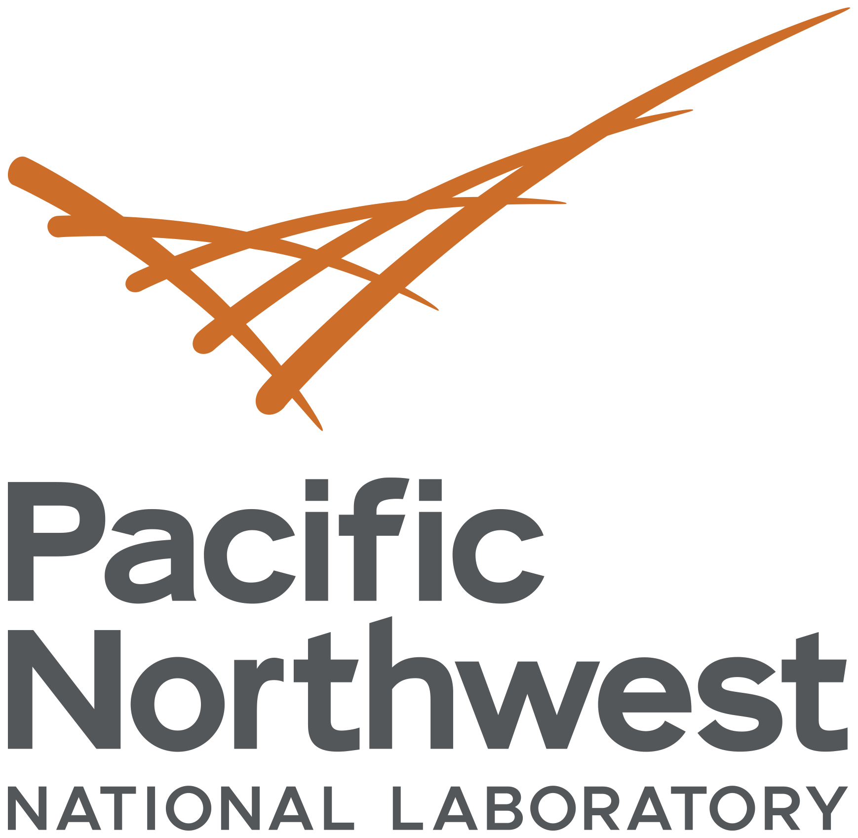

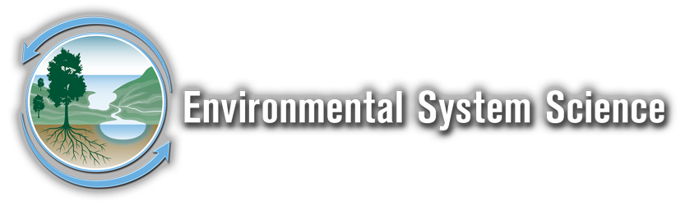

B
Burning Questions
What are the top emerging
Research priorities related to
wildfires in watersheds?
Francisco J. Guerrero
Allison Myers-Pigg
June 6, 2023

Slide 5

How can we more quickly identify emerging research and critical knowledge gaps in [watershed] science, to more effectively direct our efforts toward understanding impacts and prepare for future events?

Slide 6
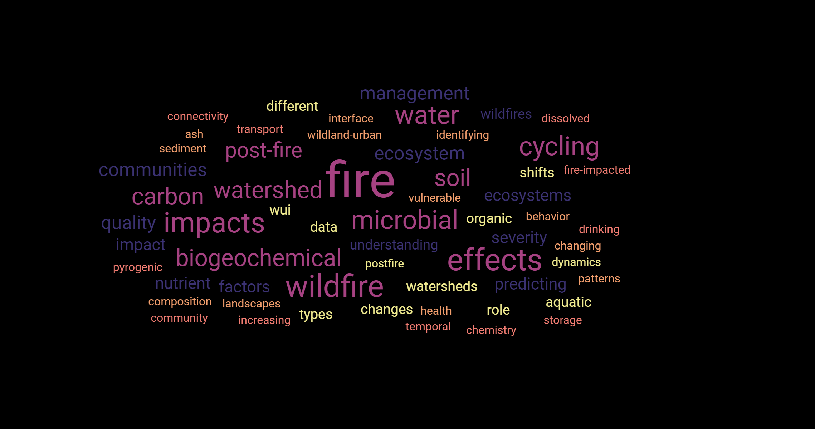
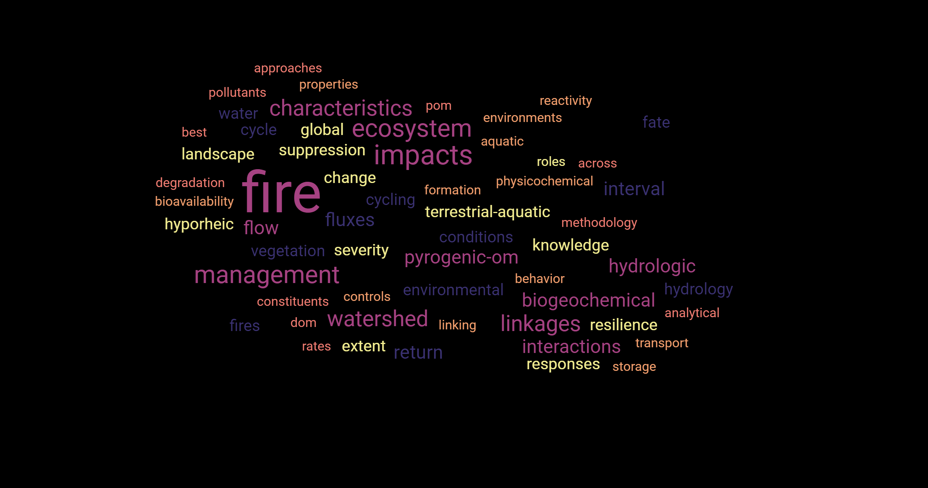

Slide 7
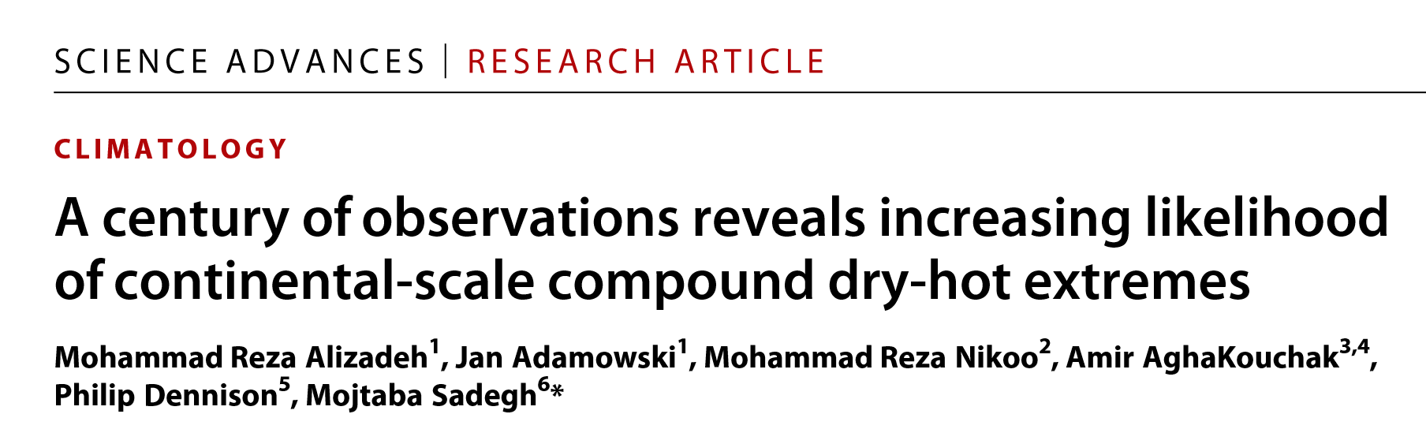
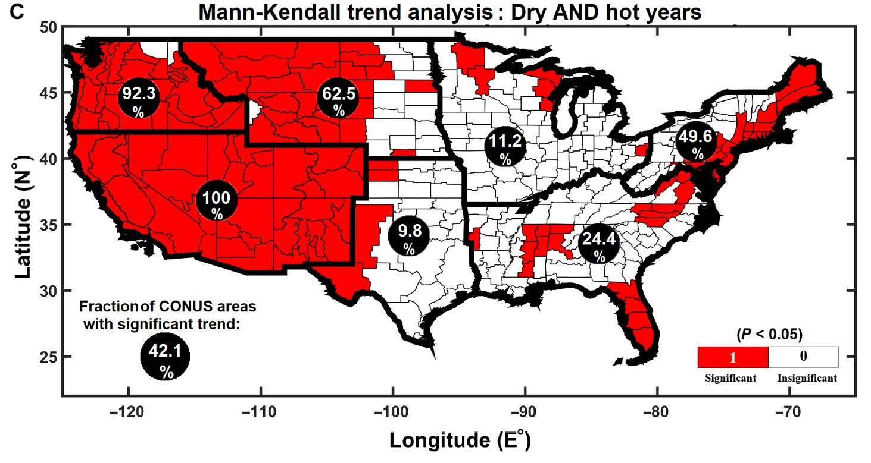
Fig. 1. Nonparametric Mann-Kendall trend analysis. Red shaded areas show a statistically significant increase (at the 5% level) in the return period level of (A) dry extremes, (B) hot extremes, and (C) concurrent dry AND hot extremes across CONUS over the past 122 years (1896–2017) at the annual scale. Fraction of area in each region and the entire CONUS with significant trends are also shown in the figure.

Slide 8
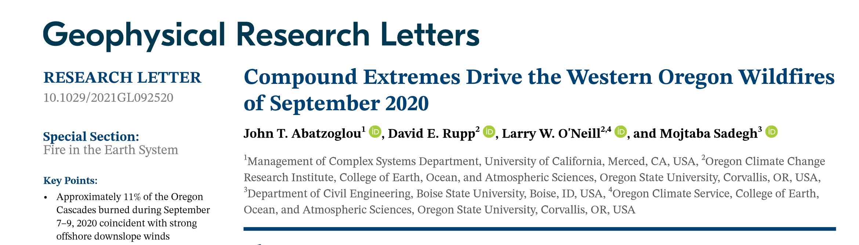
• Approximately 11% of the Oregon Cascades burned during September 7–9, 2020 coincident with strong offshore downslope winds
• Unprecedented compound extremes involving fuel aridity and fire meteorology facilitated the extent and spread of fires
• Very large fires in western Oregon since 1900 have generally occurred during east wind events at the end of anomalously warm-dry summers

Slide 9
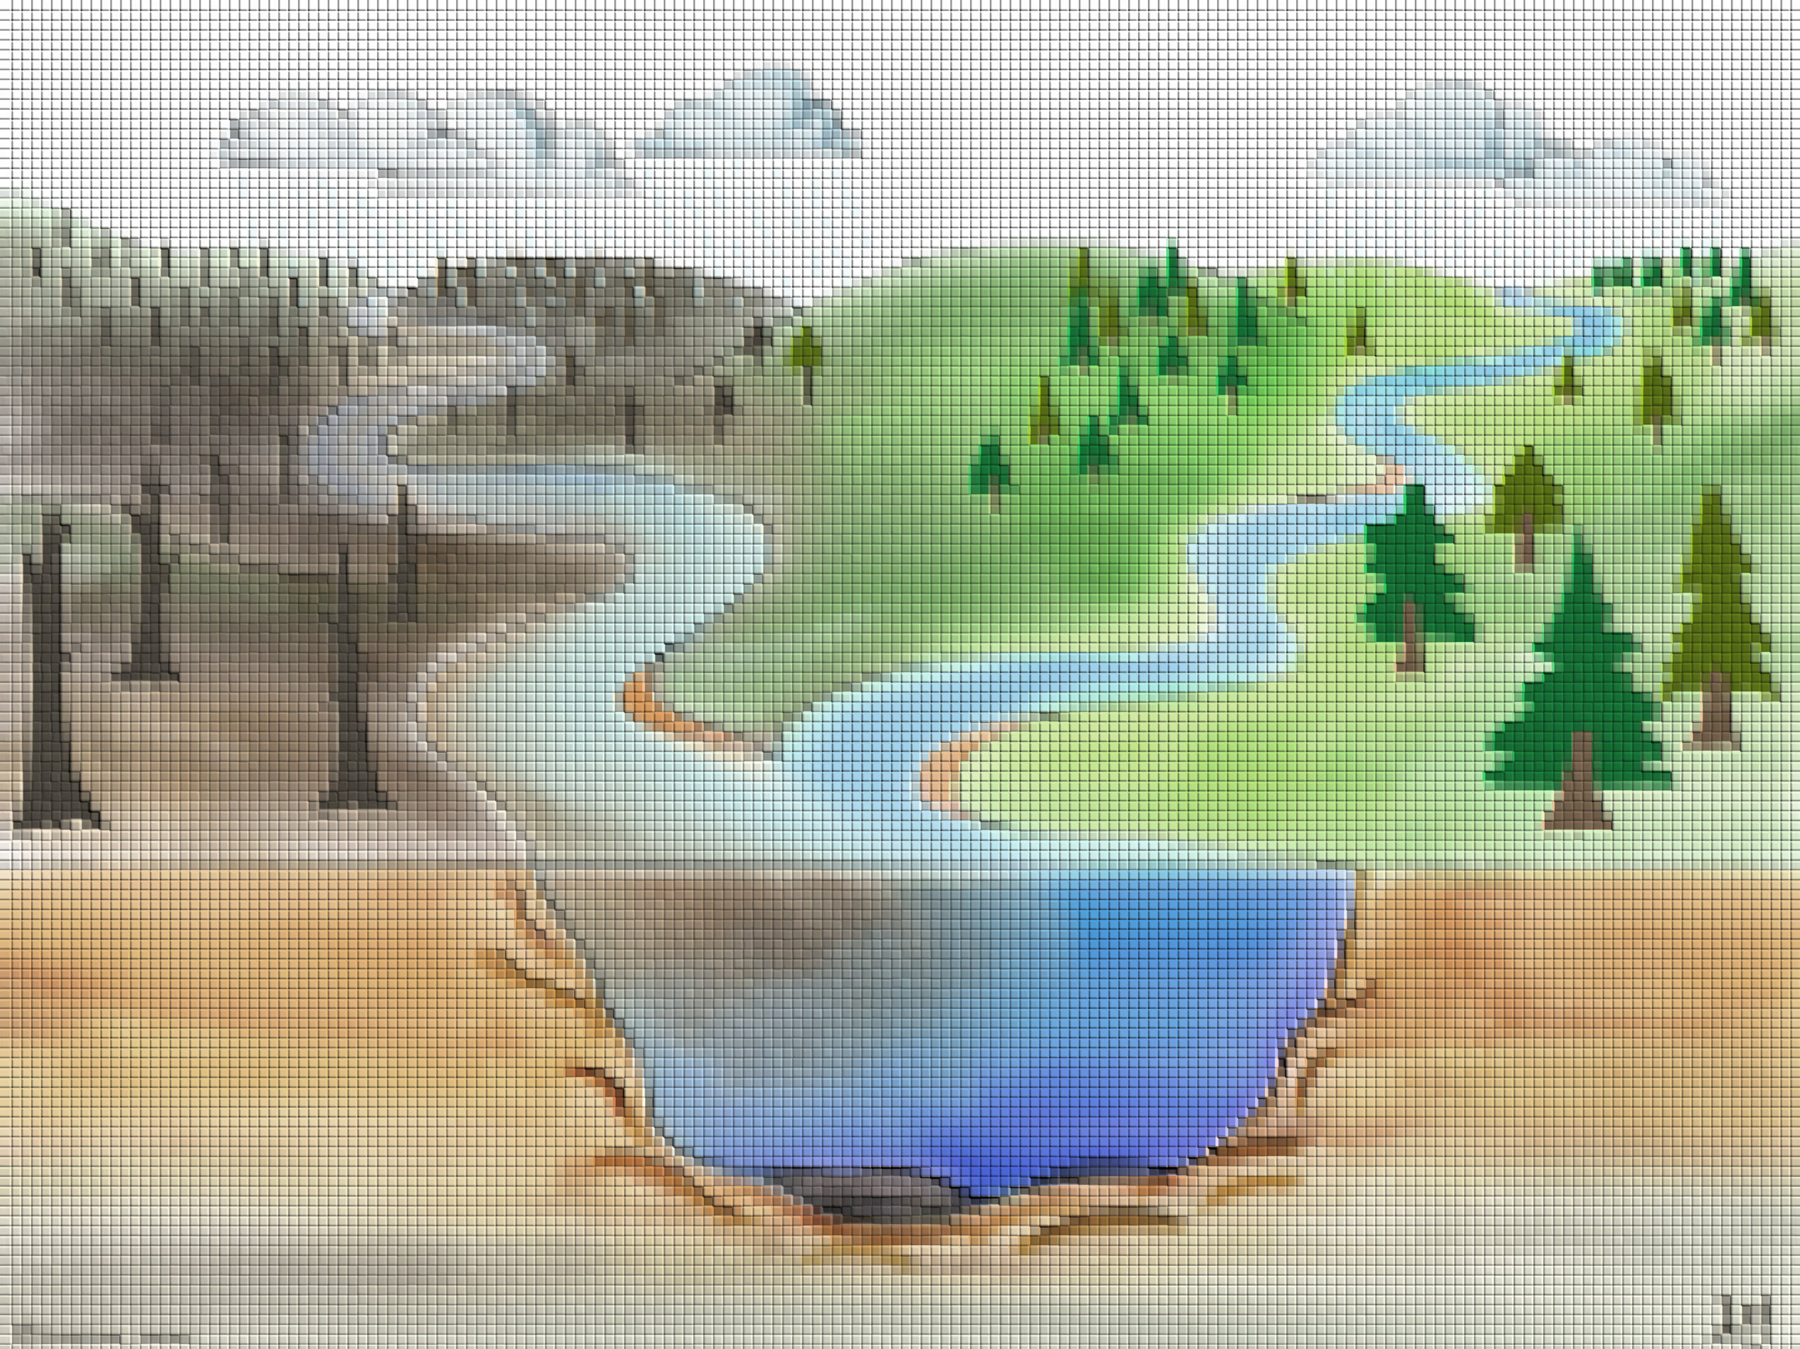

Slide 10
Wildfires and Watersheds Science: Joining a growing community

Slide 11
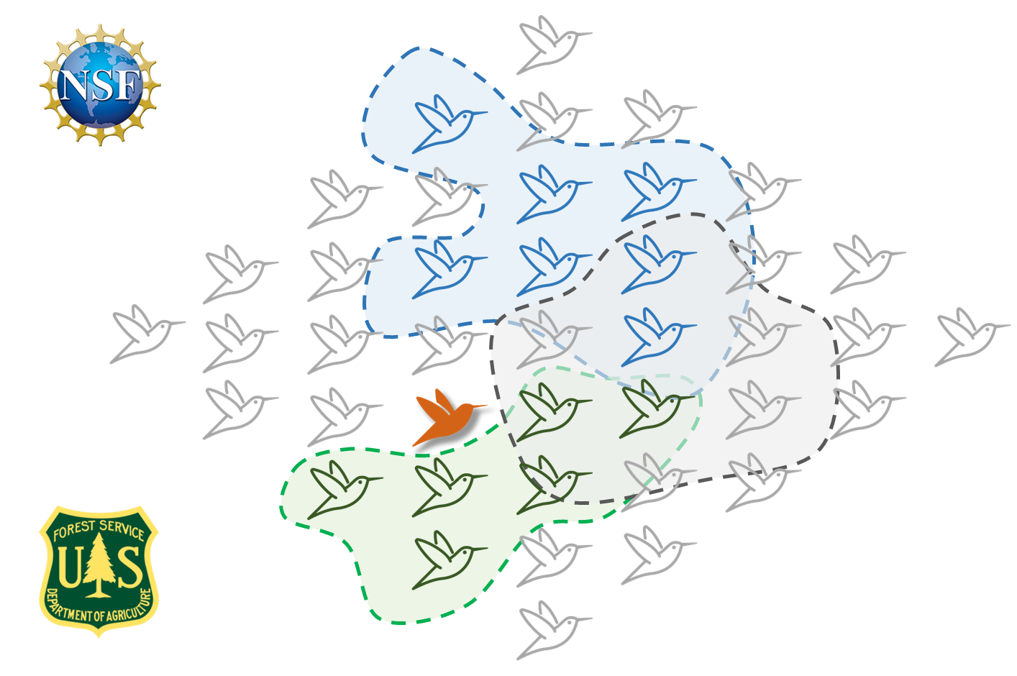
Wildfires and Watersheds Science: Joining a growing community

Slide 12
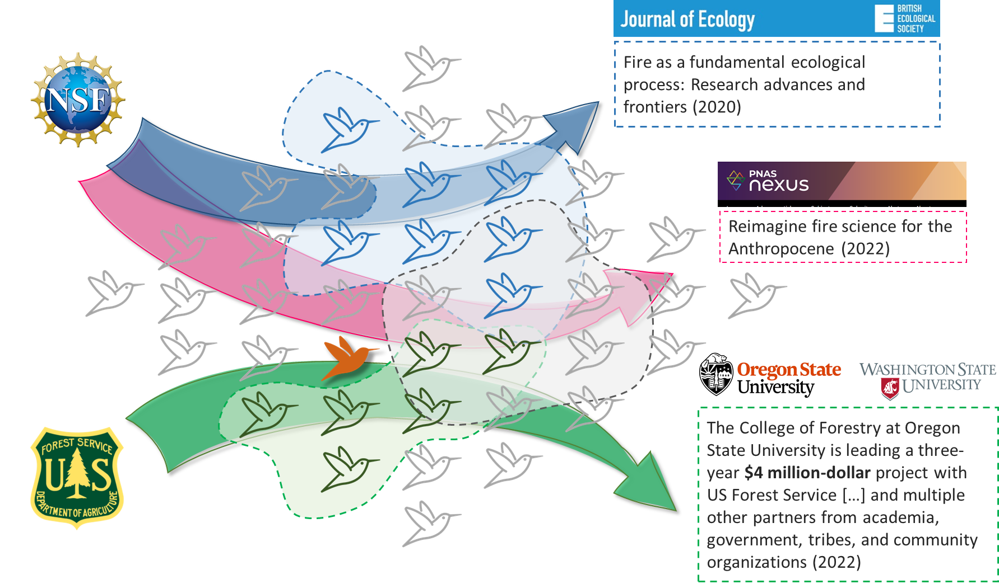
Wildfires and Watersheds Science: Joining a growing community

Slide 13
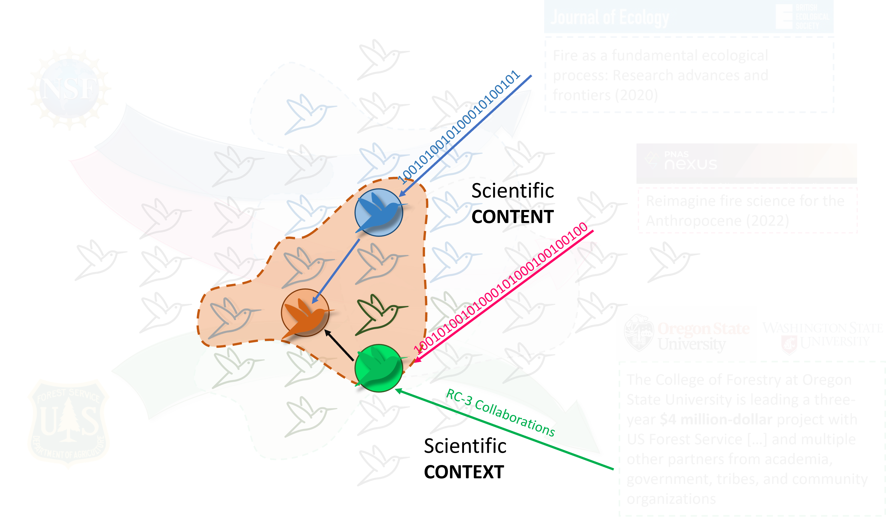
Wildfires and Watersheds Science: Content and Context

Slide 14
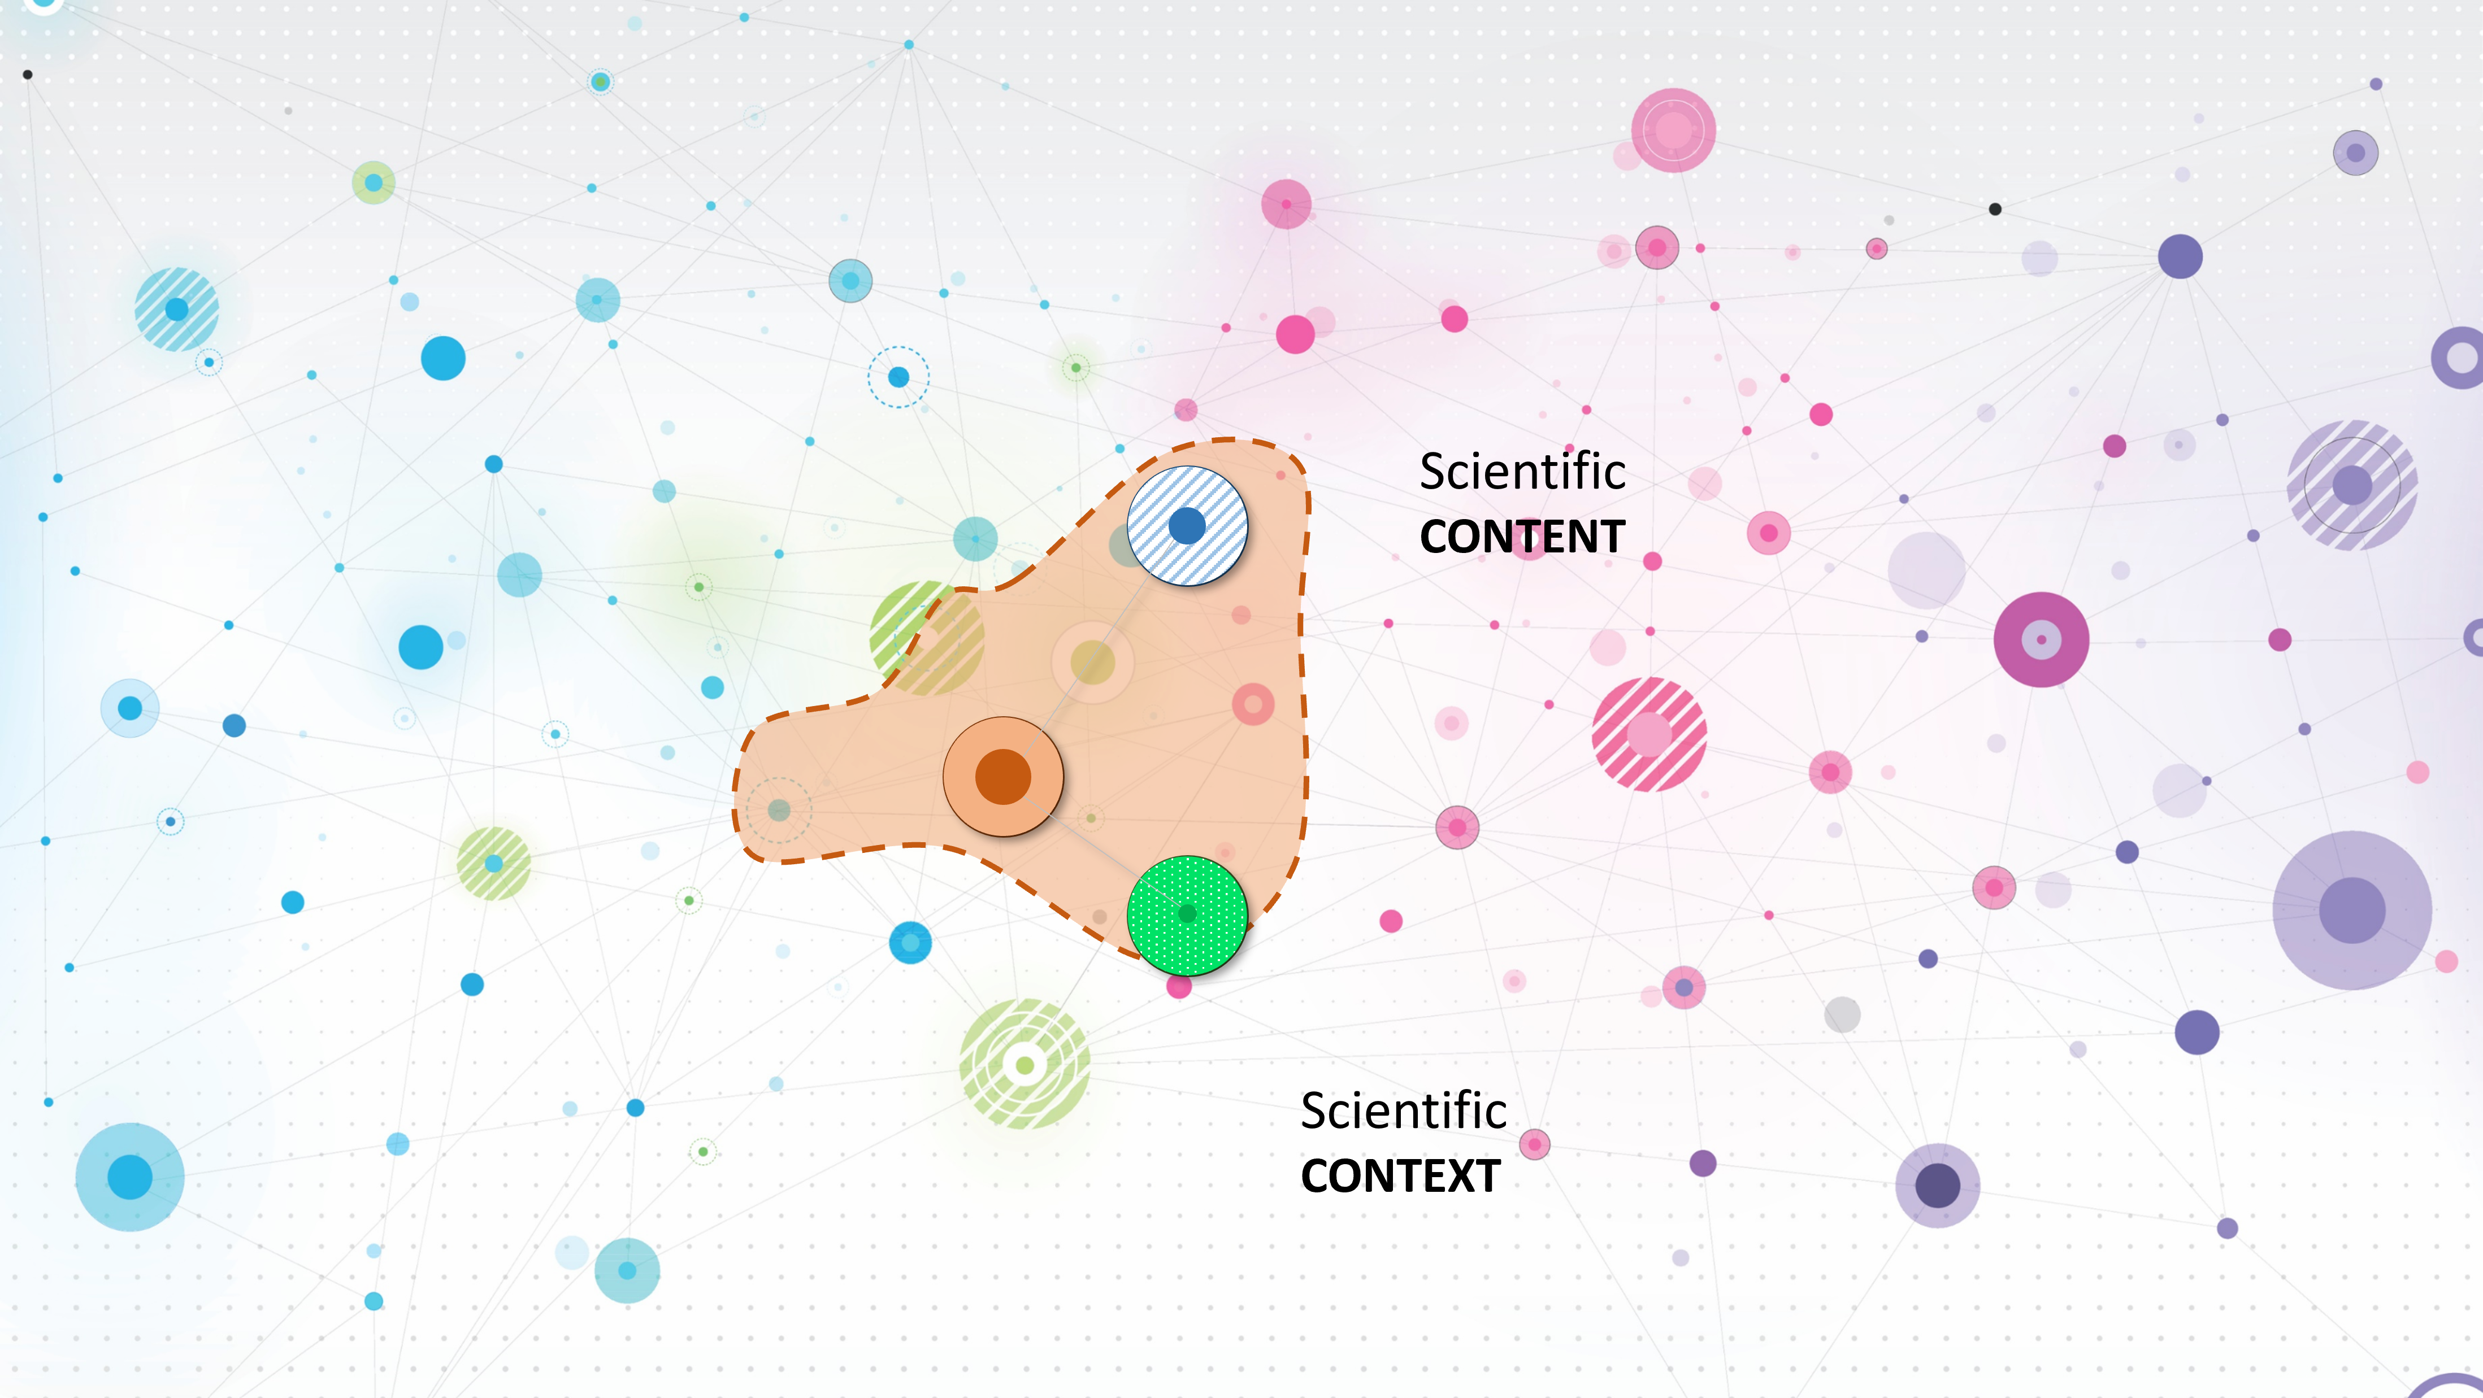
Wildfires and Watersheds Science: Content and Context

Slide 15
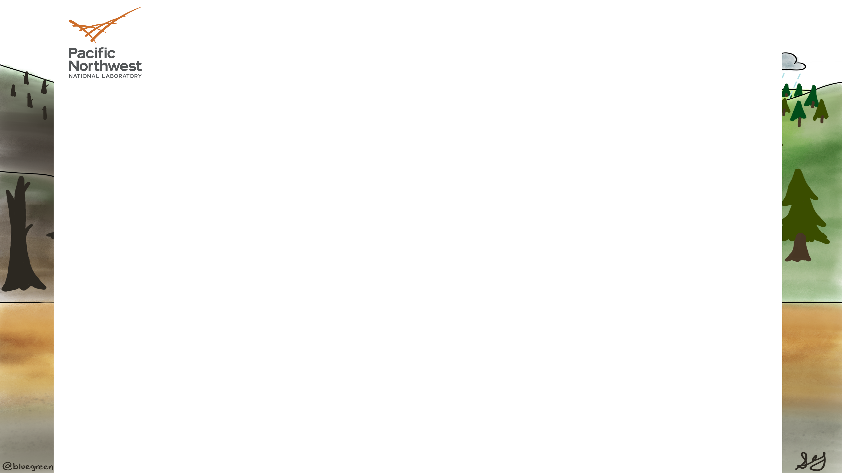
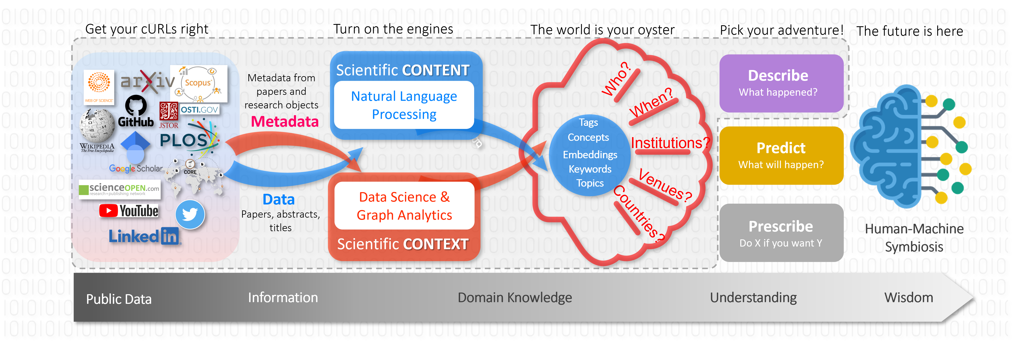

Slide 16
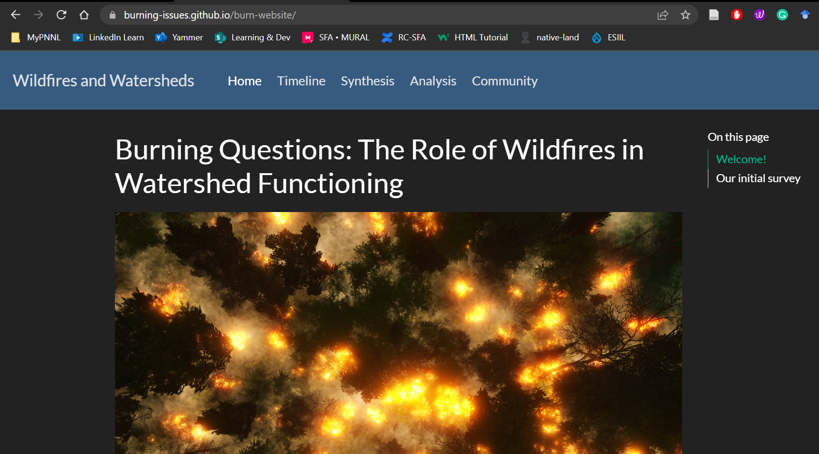
Building a community interested in wildfires & watershed function

Slide 17
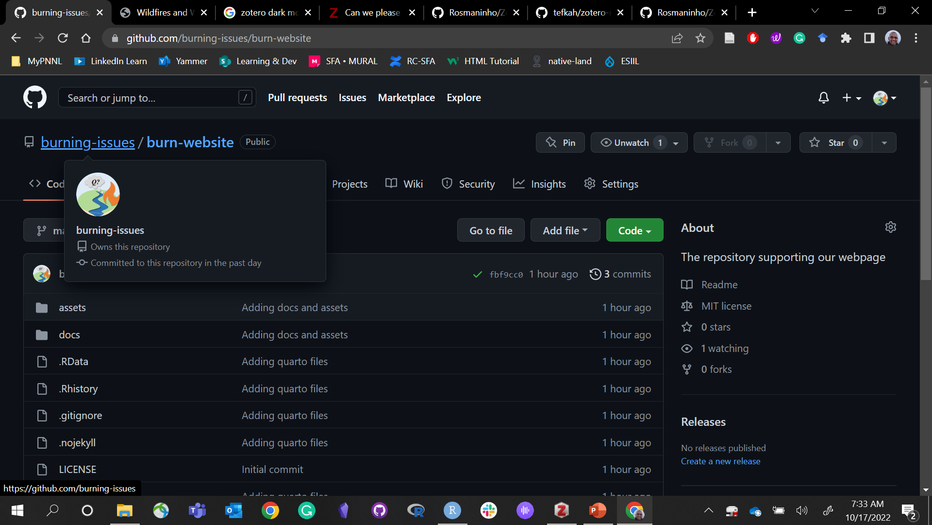
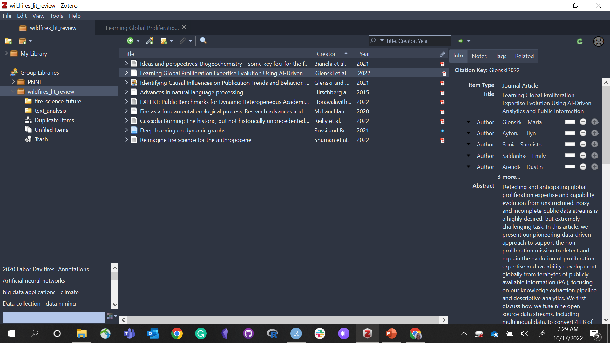
Building a community interested in wildfires & watershed function
Notes:
We have also created a GitHub repository and a Group library in Zotero with unlimited storage for every collaborator to contribute with papers and citable technical documents.

Slide 20
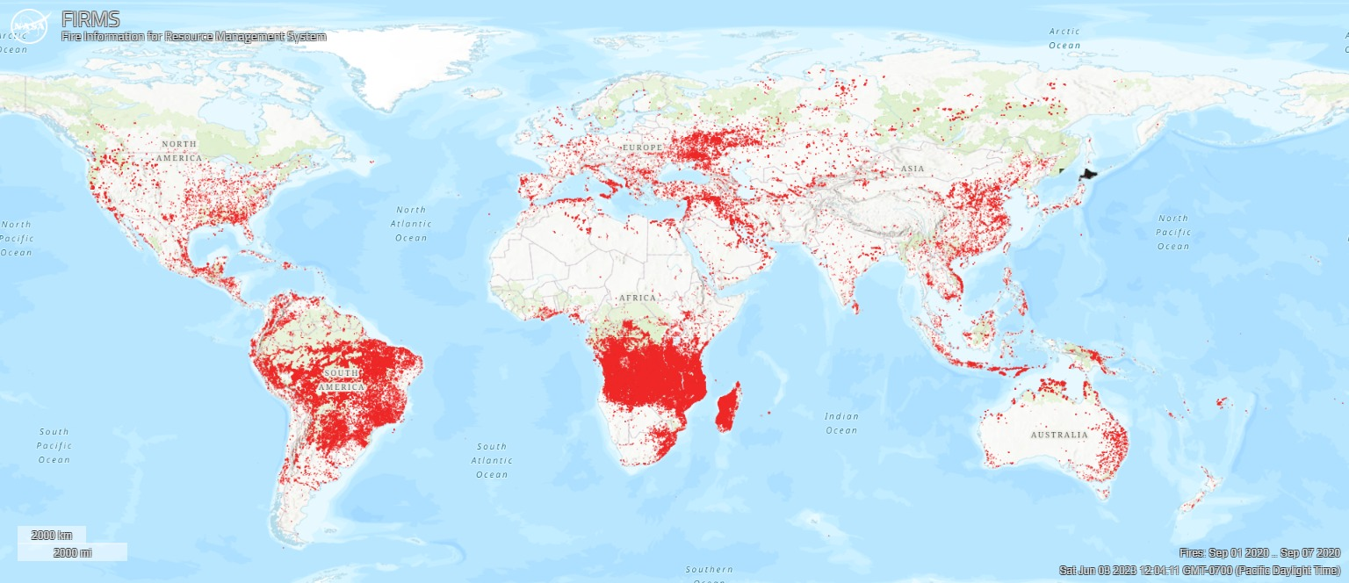

Slide 21
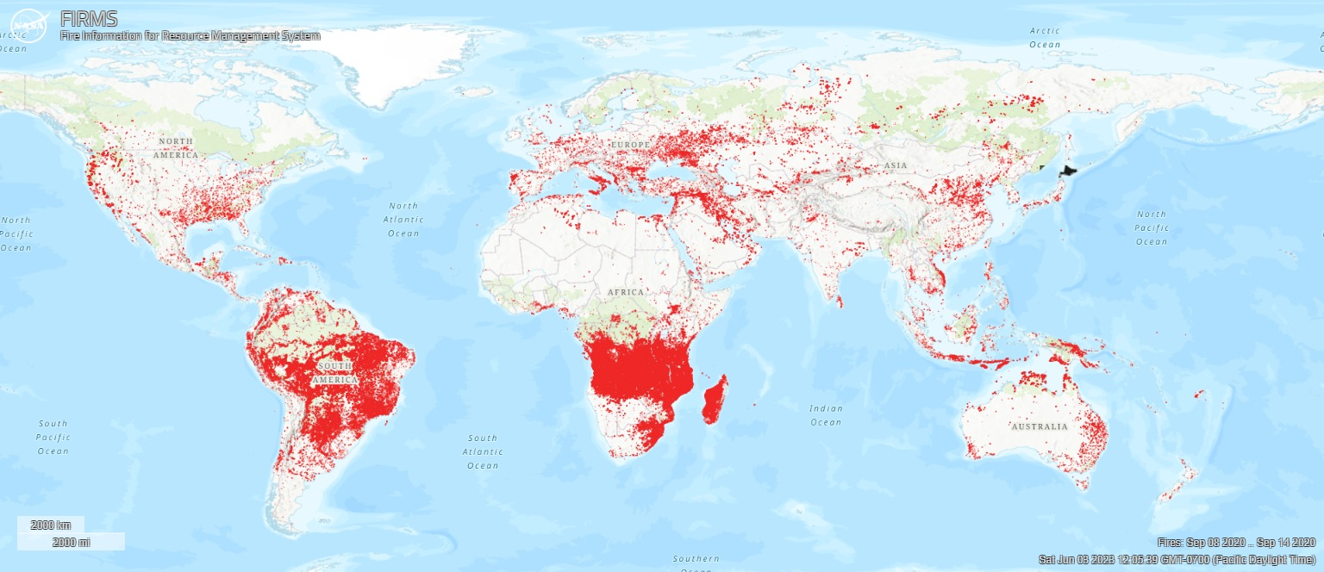

Slide 22
If machines are becoming artificially more intelligent, we must become organically wiser. Yet…

Slide 23
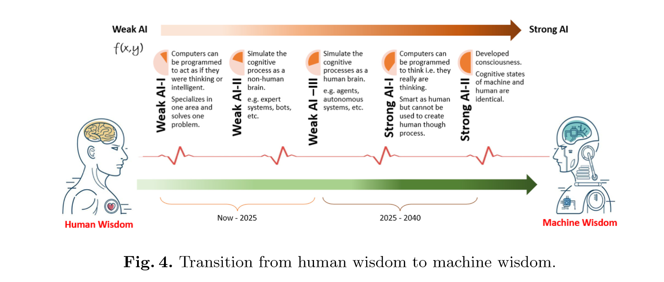
How can we more quickly identify emerging research and critical knowledge gaps in [watershed] science, to more effectively direct our efforts toward understanding impacts and prepare for future events?

